Slide 1
UNIT V: Multivariable Calculus
Partial Differentiation and Its Applications: Functions of two or more variables, partial deriative, euler theorem, total derivative, Jacobian, Maxima and Minima of functions of two variables and problems

Slide 2
Partial Derivative
The partial derivative is used in vector calculus and differential geometry.
In Mathematics, sometimes the function depends on two or more variables.
The derivative converts into the partial derivative since the function depends on several variables

Slide 3
Definition
Suppose, we have a function f(x, y), which depends on two variables x and y, where x and y are independent of each other. Then we say that the function f partially depends on x and y.
If we calculate the derivative of f, then that derivative is known as the partial derivative of f.
If we differentiate the function f with respect to x, then take y as a constant and if we differentiate f with respect to y, then take x as a constant.

Slide 4
Partial Derivative Symbol
In mathematics, the partial derivative of any function having several variables is its derivative with respect to one of those variables where the others are held constant. The partial derivative of a function f with respect to the differently x is variously denoted by f’_{x}, f_{x}, ∂_{x}f or ∂f/∂x. Here ∂ is the symbol of the partial derivative.
Example: Suppose f is a function in x and y then it will be expressed by f(x, y). So, the partial derivative of f with respect to x will be ∂f/∂x keeping y as constant. It should be noted that it is ∂x, not dx. ∂f/∂x is also known as f_{x}.

Slide 5
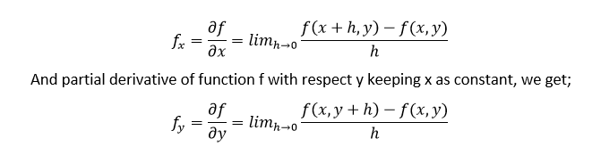
Partial Derivative Formula
If f(x,y) is a function, where f partially depends on x and y and if we differentiate f with respect to x and y then the derivatives are called the partial derivative of f.
The formula for partial derivative of f with respect to x taking y as a constant is given by;

Slide 6
Partial Differentiation
The process of finding the partial derivatives of a given function is called partial differentiation. Partial differentiation is used when we take one of the tangent lines of the graph of the given function and obtaining its slope.

Slide 7
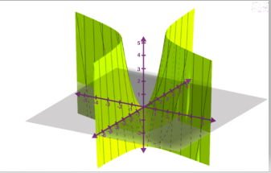
Example
Suppose that f is a function of more than one variable such that, f = x² + 3xy
The graph of z = x² + 3xy is given below:
The graph of this function represents a surface in Euclidean space. To each point on this surface, there is an infinite number of tangent lines. Now, we can apply the partial differentiation for choosing one of these lines and finding its slope.

Slide 8
To find the tangent line’s slope to the function at one point, say P(1,1) and parallel to the xz-plane, we treat y as a constant. By finding the derivative of the equation taking y as a constant, we can get the slope of the given function f at the point (x, y).
This can be done as follows. ∂f/∂x = (∂/∂x) (x² + 3xy) = 2x + 3y The value of ∂f/∂x at (1, 1) is: 2(1) + 3(1) = 5 That means the slope is 5. Therefore, ∂f/∂x = 5 at (1, 1).

Slide 9
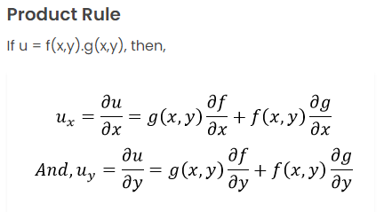
Partial Derivative Rules

Slide 10
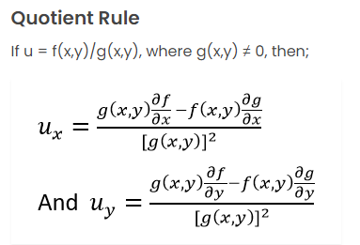
Partial Derivative Rules

Slide 11
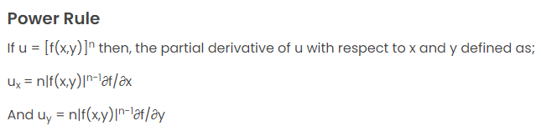
Partial Derivative Rules

Slide 12
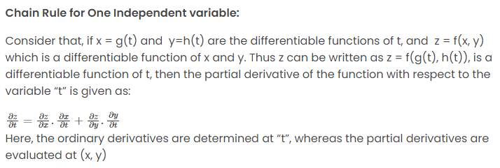
Partial Derivative Rules

Slide 13
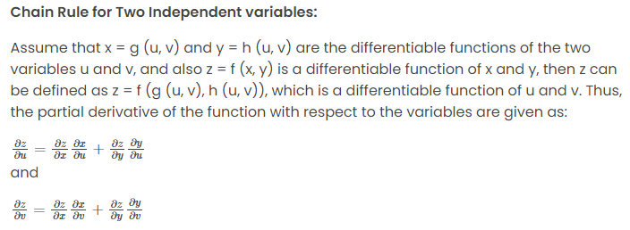
Partial Derivative Rules

Slide 14
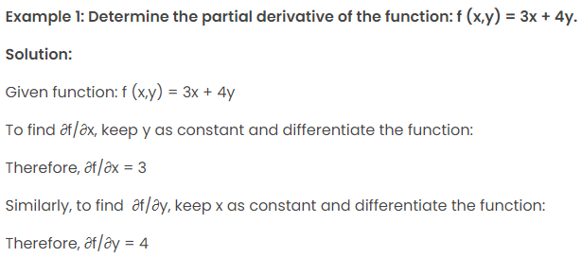
Partial Derivative Examples

Slide 15
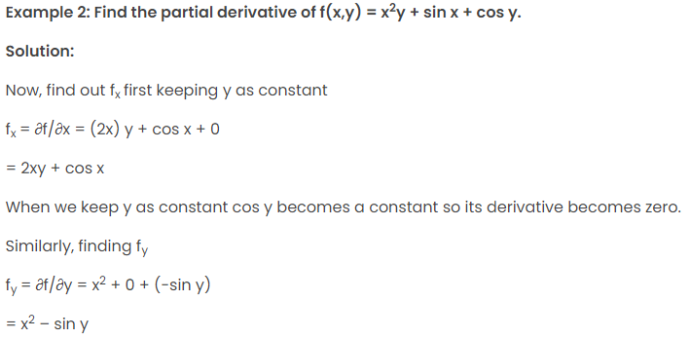
Partial Derivative Examples

Slide 16
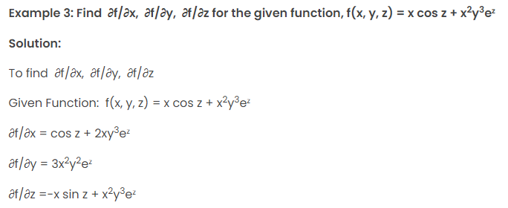
Partial Derivative Examples

Slide 17
Jacobian matrix
Jacobian matrix is a matrix of partial derivatives. Jacobian is the determinant of the jacobian matrix. The matrix will contain all partial derivatives of a vector function. The main use of Jacobian is found in the transformation of coordinates. It deals with the concept of differentiation with coordinate transformation.

Slide 18
Jacobian matrix
The term “Jacobian” often represents both the jacobian matrix and determinants, which is defined for the finite number of function with the same number of variables.
Here, each row consists of the first partial derivative of the same function, with respect to the variables.
The jacobian matrix can be of any form. It may be a square matrix (number of rows and columns are equal) or the rectangular matrix(the number of rows and columns are not equal).

Slide 19
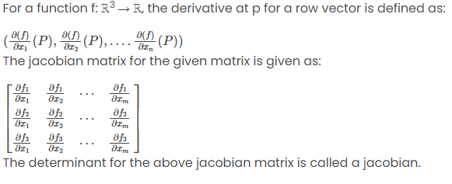
Jacobian Matrix

Slide 20
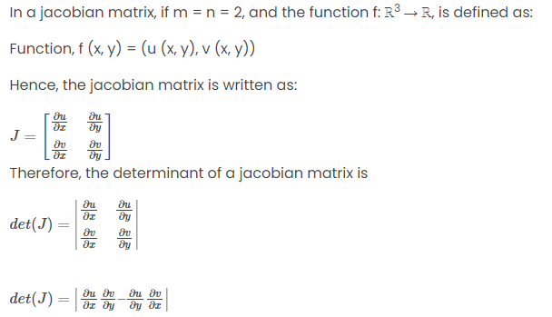
Jacobian Determinant

Slide 21
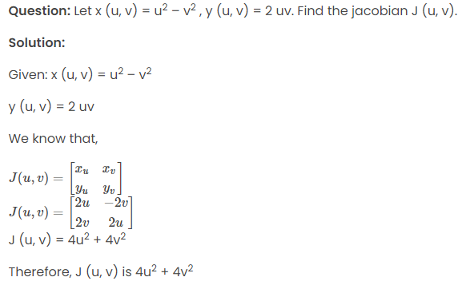
Jacobian Example

Slide 22

Euler theorem
With the help of Euler’s theorem for homogeneous functions we can establish a relationship between the partial derivatives of a function and the product of functions with its degrees.

Slide 23
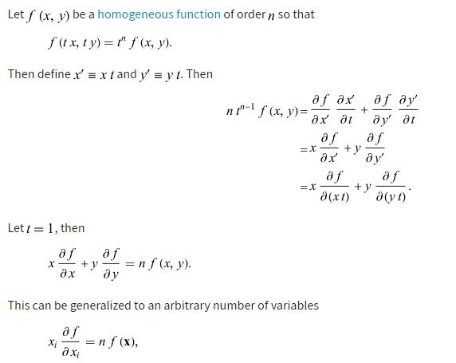
Euler theorem

Slide 24
Maxima and Minima of functions of two variables
Let f be a function with two variables with continuous second order partial derivatives f_{xx}, f_{yy} and f_{xy} at a critical point (a,b). Let D = f_{xx}(a,b) f_{yy}(a,b) - f_{xy}²(a,b) then
a) If D > 0 and f_{xx}(a,b) > 0, then f has a relative minimum at (a,b). b) If D > 0 and f_{xx}(a,b) < 0, then f has a relative maximum at (a,b). c) If D < 0, then f has a saddle point at (a,b). d) If D = 0, then no conclusion can be drawn.

